Slide 1
PROJECT TITLE SECURE DATA HIDING IN IMAGES USING STEGANOGRAPHY
SECURE THE DATA TO PREVENT HACKERS
Presented By:Sheetal
Student Name : Sheetal
College Name & Department :Deenbandhu Chhotu Ram University Of Science and Technology & M.Sc. mathematics

Slide 2
OUTLINE
Problem Statement
Technology used
Wow factor
End users
Result
Conclusion
Git-hub Link
Future scope

Slide 3
Problem Statement
The increasing risk of cyber threats and data breaches calls for secure communication methods.
Traditional encryption is detectable, making it a target for hackers.
Steganography hides data within images, ensuring secure and unnoticed communication.
This project focuses on implementing image steganography to protect sensitive information.

Slide 4
Technology used
Programming Language: Python
Libraries: OpenCV, NumPy, PIL (Python Imaging Library)
Algorithm: Least Significant Bit (LSB) Steganography

Slide 5
Wow factors
Encrypts and hides text inside an image without changing its appearance.
The hidden data is nearly impossible to detect visually.
Can be used for secure messaging and digital watermarking.
Simple and lightweight implementation with a user-friendly interface.

Slide 6
End users
Government agencies (for secure communication).
Journalists and whistleblowers (for confidential information sharing).
Cybersecurity professionals (for data protection).
General users who want to protect sensitive data.

Slide 7
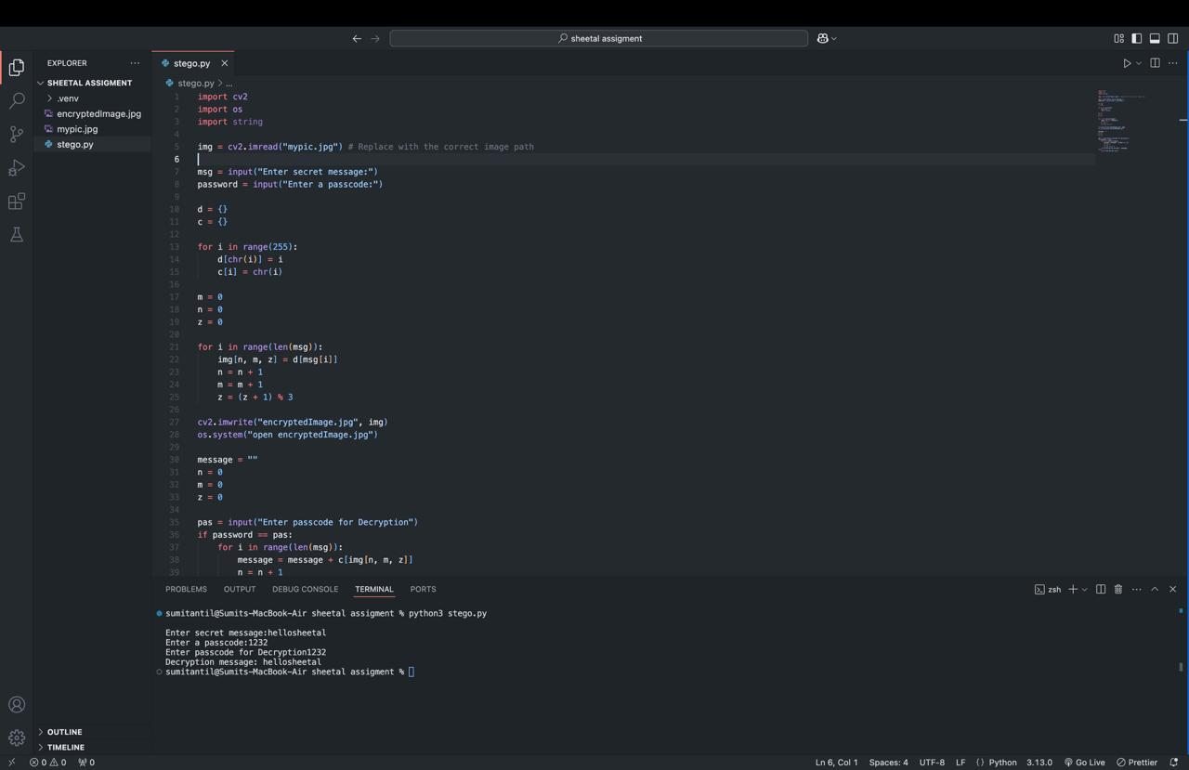


Results

Slide 8
Conclusion
Steganography provides an effective way to securely transmit data without attracting attention.
The project successfully embeds and retrieves secret messages from images.
Future work can include improving security with encryption before hiding data.

Slide 9
GitHub Link
https://github.com/sheetalantil/stenography.git

Slide 10
Future scope(optional)
Implementing more advanced steganography techniques (e.g., frequency domain methods).
Adding encryption before hiding data for an extra security layer.
Creating a mobile or web application for easy use.

Slide 11
THANK YOU

